Slide 1
Hardware Fundamentals
What is Hardware?
Hardware is the physical aspect of the computer, the thing we can touch.
A Computer is a Hardware and is an electronic device that manipulates information, or data using different input and output devices.

Slide 2
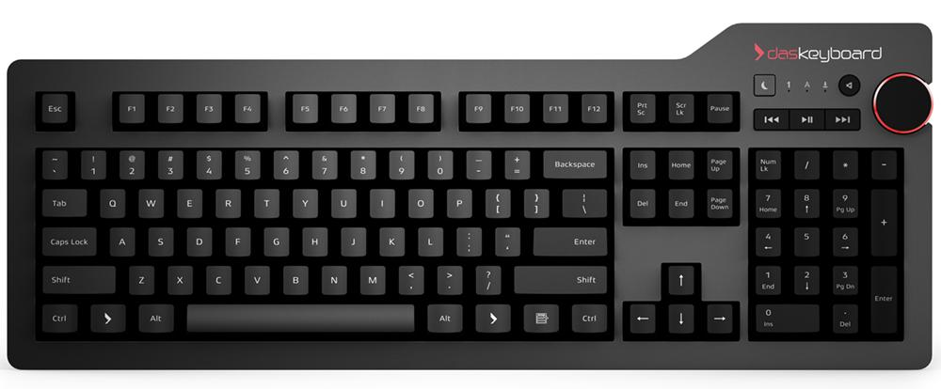
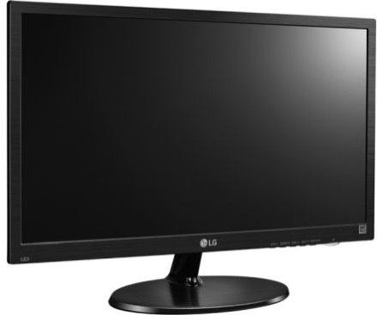
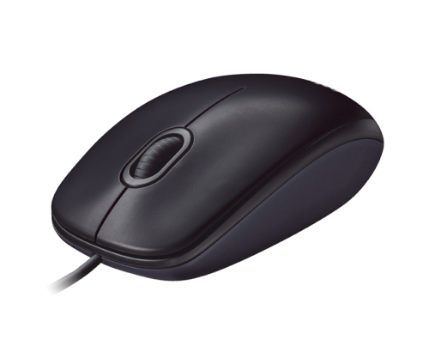
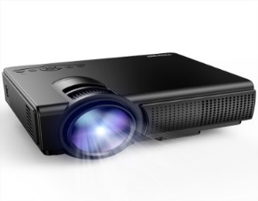
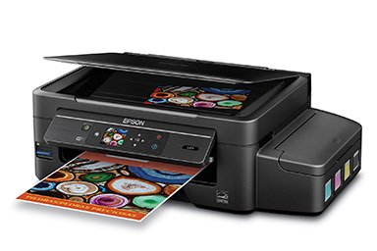
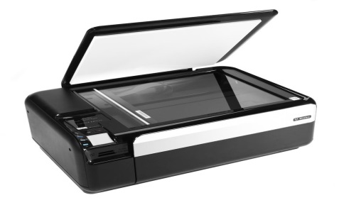
Computer
INPUT DEVICES
OUTPUT DEVICES
Keyboard
Monitor
Projector
Mouse
Scanner
Printer

Slide 3
Monitor
Monitor is an output devices which displays the information or output into pictorial form.
Monitors are connected to the computer via VGA,HDMI or other proprietary connectors through DB5 connector of motherboard.
Multiple technologies have been used for computer monitors like CRT,LCD and LED.

Slide 4
Cathode Ray Tube (CRT)
The cathode ray tube (CRT) is a vacuum tube that contain one or more electron guns and a phosphorescent screen, and is used to display images.
It modulates, accelerates, and deflects electron beams onto the screen to create the images.
Working of CRT

Slide 5
Disadvantages of CRT
The CRT's produces images with softer edges that are not as sharp as an LCD at its native resolution.
Imperfect focus and color registration also reduce sharpness.
Relatively bright but not as bright as LCDs.
Produces electrostatics radiation which is harmful for eye’s
CRT’s monitors acquire more space as compared to LCD’s.

Slide 6
Liquid Crystal Display (LCD)
A liquid-crystal display (LCD) is a flat-panel display that uses the light-modulating properties of liquid crystals.
Liquid crystals do not emit light directly, instead using a backlight or reflector to produce images in color or monochrome.
Working of LCD

Slide 7
Need of LED
1. Resolution Each panel has a fixed pixel resolution format determined at the time of manufacture that can not be changed. All other image resolutions require rescaling, which generally results in significant image degradation, particularly for fine text and graphics. For most applications should only be used at the native resolution of the panel. If you need fine text and graphics at more than one resolution do not get an LCD display.
2. Viewing Angle Limited viewing angle. Brightness, contrast, gamma and color mixtures vary with the viewing angle. Can lead to contrast and color reversal at large angles. Need to be viewed as close to straight ahead as possible.
3. Cost Considerably more expensive than comparable CRTs which forces the use of LED.

Slide 8
Light-Emitting Diode (LED)
A light-emitting diode (LED) is a two-lead semiconductor light source. It is a p-n junction diode that emits light when activated.
When a suitable current is applied to the leads,[electrons are able to recombine with electron holes within the device, releasing energy in the form of photons.
This effect is called electroluminescence, and the color of the light (corresponding to the energy of the photon) is determined by the energy bandgap of the semiconductor.
LEDs are typically small (less than 1 mm2) and integrated optical components may be used to shape the radiation pattern.
Appearing as practical electronic components in 1962, the earliest LEDs emitted low-intensity infrared light.
Infrared LEDs are still frequently used as transmitting elements in remote-control circuits, such as those in remote controls for a wide variety of consumer electronics. The first visible-light LEDs were of low intensity and limited to red. Modern LEDs are available across the visible, ultraviolet, and infrared wavelengths, with very high brightness.

Slide 9
Keyboard
In computing, a computer keyboard is a typewriter-style device which uses an arrangement of buttons or keys to act as a mechanical lever or electronic switch. Following the decline of punch cards and paper tape, interaction via teleprinter-style keyboards became the main input device for computers.
A keyboard typically has characters engraved or printed on the keys (buttons) and each press of a key typically corresponds to a single written symbol.
However, to produce some symbols requires pressing and holding several keys simultaneously or in sequence.
While most keyboard keys produce letters, numbers or signs (characters), other keys or simultaneous key presses can produce actions or execute computer commands.

Slide 10
Mechanism of keyboard

Slide 11
Mouse
A computer mouse is a hand-held pointing device that detects two-dimensional motion relative to a surface.
This motion is typically translated into the motion of a pointer on a display, which allows a smooth control of the graphical user interface.
Mice originally used a ball rolling on a surface to detect motion, but modern mice often have optical sensors that have no moving parts.
In addition to moving a cursor, computer mice have one or more buttons to allow operations such as selection of a menu item on a display.

Slide 12
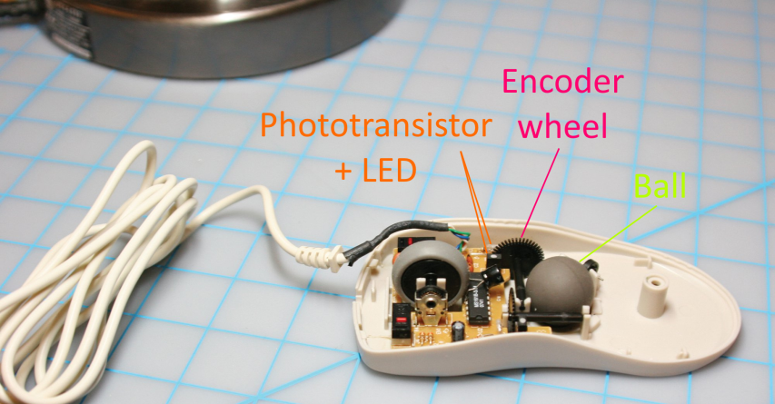
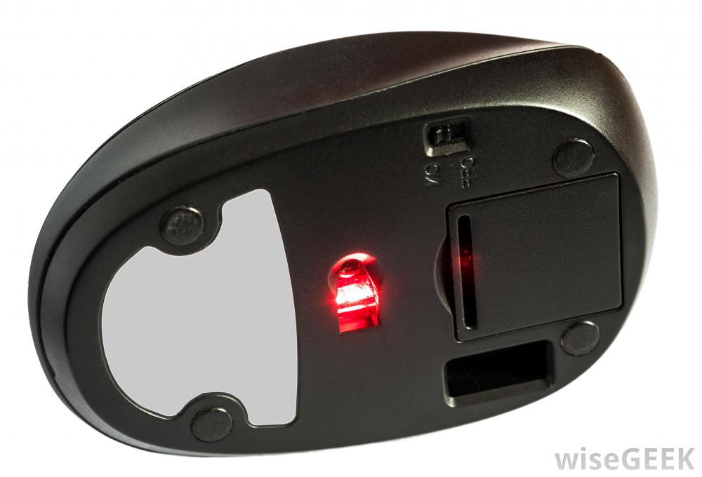

Slide 13
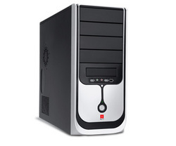
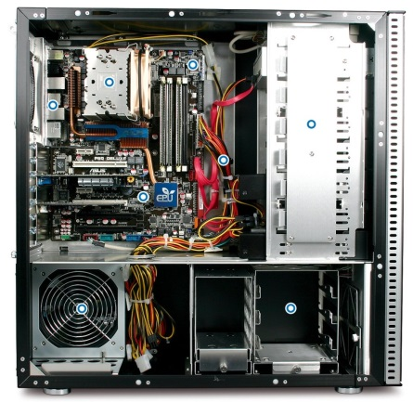
Cabinet
Cabinet not only composed of CPU ,Hard disk but also various Hardware which are connected internally so that the computer works properly.
Cabinet size depends on size of motherboards and internal components

Slide 14
Connectors

Slide 15
Motherboard
A printed circuit board containing the principal components of a computer or other device, with connectors for other circuit boards to be slotted into.
Thin layers of copper or aluminum foil, referred to as traces, are printed onto this board.
Traces are very narrow and form the circuits between the various components.

Slide 16
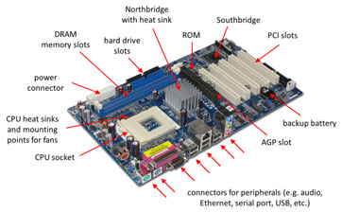

Slide 17
Components of Motherboard
A CPU socket - the actual CPU is directly soldered onto the socket. Since high speed CPUs generate a lot of heat, there are heat sinks and mounting points for fans right next to the CPU socket.
A power connector to distribute power to the CPU and other components.
Slots for the system's main memory(RAM), typically in the form of DRAM chips.
A chip forms an interface between the CPU, the main memory and other components is referred to as the Northbridge.

Slide 18
A second chip controls the input and output (I/O) functions is referred to as the Southbridge.
Read-only memory (ROM) chip, which contains the firmware, or startup instructions for the computer system. This is also called the BIOS.
A slot for a video or graphics card including the Accelerated Graphics Port (AGP).
Additional slots to connect hardware in the form of Peripheral Component Interconnect (PCI) slots.

Slide 19
Microprocessor
A Microprocessor is a computer processor which incorporates the functions of a computer's central processing unit (CPU) on a single integrated circuit (IC),or at most a few integrated circuits.
Thousands of transistors are integrated to form a microprocessor.

Slide 20
Multiprocessing
Multiprocessing is the use of two or more central processing
units (CPUs) within a single computer system.
The term also refers to the ability of a system to support more
than one processor or the ability to allocate tasks between them.
Multithreading
Multithreading is the ability of a central processing unit (CPU) or
a single core in a multi-core processor to execute multiple
processes or threads concurrently, appropriately supported by
the operating system.
Multitasking
Multitasking is the concurrent execution of multiple tasks (also
known as processes) over a certain period of time.
New tasks can interrupt already started ones before they finish,
instead of waiting for them to end.

Slide 21
Time sharing
Time-sharing is the sharing of a computing resource among
many users by means of multiprogramming and multi-tasking at
the same time.
Hyper Threading
Hyper-threading (officially called Hyper-Threading Technology or
HT Technology, and abbreviated as HTT or HT) is Intel's proprietary
simultaneous multithreading (SMT) implementation used to
improve parallelization of computations (doing multiple tasks at
once) performed on x86 microprocessors.
Timer
Counter/timer hardware is a crucial component of most embedded
systems. In some cases, a timer measures elapsed time (counting
processor clock ticks). In others, we want to count or time external
events.

Slide 22
Evolution of microprocessor
Intel 4004
First started with 4 bit- Intel 4004 in 1971.
It has 4KB main memory.
It gives 45 instruction.
It was the first programmable device which was used in calculators.
Intel 8085
It was started in 1975.
It is a 8-bit microprocessor.
It has 64KB main memory.
It will give 246 Instructions.
Intel sold 100million copies of this 8-bit microprocessor.
Uses only one +5volts power supply.

Slide 23
Intel 8086
It was started in 1978.
It is a 16-bit microprocessor.
It has 1MB main memory.
Added more registers and additional instructions.
Intel 80386
It was started in 1986.
It is a 32-bit microprocessor.
It has 4GB main memory.
It allows Page handling in virtual environment.
It has memory paging and enhances Input/output permission.

Slide 24
Pentium I
It was started in 1993.
It is a 32-bit microprocessor.
It has 4GB main memory.
It is Double clocked with 120 and 133MHz versions.
It has 16KB L1 cache(Instruction 8KB and Data 8KB).
Pentium II
It was started in mid-1997 to early 1999.
It is an Xeon version.
It has Hyper Threading.
It has 16Mb L2 Cache.
It is specialized.

Slide 25
Memory
Computer memory is the storage space in the computer, where data is to be processed and instructions required for processing are stored.
Memory is basically categorized into Volatile and Non volatile memory.
Volatile memory is computer memory that requires power to maintain the stored information.
Non-volatile memory is computer memory that can retain the stored information even when not powered.

Slide 26
Cached Memory
Cache memory acts as a buffer between the CPU and the main memory which can speed up the CPU.
It is used to hold those parts of data and program which are most frequently used by the CPU.
It is a Volatile memory, stores data for temporary use.
Cache memory is faster than main memory.

Slide 27
Main Memory
Main memory holds only those data and instructions on which the computer is currently working.
The data and instruction required to be processed resides in the main memory.
It is divided into two subcategories RAM .
It is a Volatile memory and computer cannot run without the main memory.

Slide 28
Random Access Memory (RAM)
RAM is primarily used by CPU to access the memory for processing ,computing and storing the results.
RAM is volatile, Hence, a backup Uninterruptible Power System (UPS) is often used with computers.
RAM is small, both in terms of its physical size and in the amount of data it can hold.
RAM is classified into SRAM and DRAM.

Slide 29
Static RAM (SRAM)
The word static indicates that the memory retains its contents as long as power is being supplied.
However, data is lost when the power gets down due to volatile nature.
SRAM chips use a matrix of 6-transistors and no capacitors.
SRAM is thus used as cache memory and has very fast access as compared to DRAM.
It is not only expensive but also high power consuming.
SRAMs are used in a wide range of situations – networking, aerospace, and medical, among many others.

Slide 30
Dynamic RAM (DRAM)
DRAM, unlike SRAM, must be continually refreshed in order to maintain the data.
This is done by placing the memory on a refresh circuit that rewrites the data several hundred times per second.
DRAM is used for most system memory as it is cheap and small.
All DRAMs are made up of memory cells, which are composed of one capacitor and one transistor.
It is less expensive and less power consuming.

Slide 31
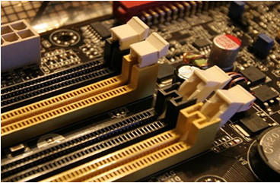
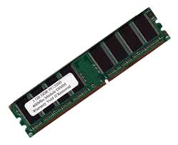
Double data rate SDRAM (DDR) was a later development of SDRAM, used in PC memory beginning in 2000.
Subsequent versions are numbered sequentially (DDR2, DDR3, etc.).
DDR SDRAM internally performs double-width accesses at the clock rate, and uses a double data rate interface to transfer one half on each clock edge.

Slide 32
Read Only Memory (ROM)
ROM is non-volatile memory from which we can only read but cannot write on it.
The information is stored permanently in such memories during manufacture.
A ROM stores such instructions that are required to start a computer. This operation is referred to as bootstrap.
ROM chips are not only used in the computer but also in other electronic items like washing machine and microwave oven.

Slide 33
Types of ROM
MROM (Masked ROM)
These kind of ROMs contains a pre-programmed set of data or instructions.
Information is stored permanently in such memories during manufacture.
PROM (Programmable Read Only Memory)
PROM is read-only memory that can be modified only once by a user.
It can be programmed only once and is not erasable.

Slide 34
EPROM (Erasable and Programmable ROM)
Instructions programed in EPROM can be erase by exposing it to ultra-violet light.
This mechanism helps the reusability of ROM for programming any device.
EEPROM (Electrically Erasable and Programmable ROM)
EEPROM is programmed and erased electrically.
Any location can be selectively erased and programmed.
EEPROMs can be erased one byte at a time, hence the process of reprogramming is flexible but slow.

Slide 35
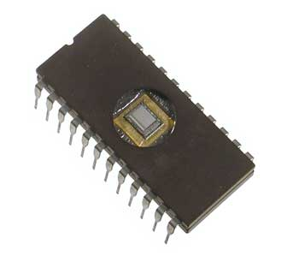
ROM

Slide 36
Virtual Memory
Virtual memory is a memory management capability of an OS that uses hardware and software to allow a computer to compensate for physical memory shortages by temporarily transferring data from RAM to disk storage.
Paging is a method of writing data to, and reading it from, secondary storage for use in primary storage, also known as main memory.
The OS reads data from secondary storage in blocks called pages, all of which have identical size.

Slide 37
Secondary Memory

Slide 38
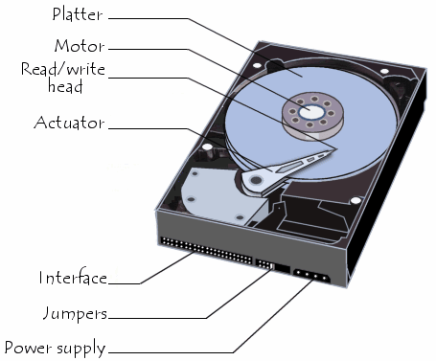
Hard Disk
Date invented:24 December 1954; 63 years ago.
Invented by :IBM team led by Rey Johnson.
What is Hard Disk?
A hard disk drive (HDD), hard disk, hard drive or fixed disk is a data storage device that uses magnetic storage to store and retrieve digital information using one or more rigid rapidly rotatingdisks (platters) coated with magnetic material.

Slide 39
Major Components in HardDisk The hard drive, which typically provides storage for data and applications within a computer,has four key components inside its casing is.. 1)The platter (for storing data), 2)The spindle (for spinning the platters), 3)The read/write arm (for reading and writing data)and 4)The actuator (for controlling the actions of the read/write arm).

Slide 40
How it works?
Platter:
The platters are the circular discs inside the hard drive where the 1s and 0s that make up your files are stored.
The Spindle:
The spindle keeps the platters in position and rotates them as required.
A typical internal desktop drive runs at 7,200 RPM, though faster and slower speeds are available.
The Read/Write Arm:
The read/write arm controls the movement of the read/write heads, which do the actual reading and writing on the disk
platters by converting the magnetic surface into an electric current.

Slide 41
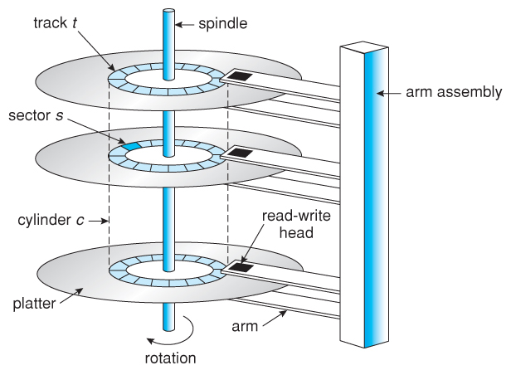
Actuator:
The actuator or head actuator is a small motor that takes instructions from the drive's circuit board to control the
movement of the read/write arm and supervise the transfer of data to and from the platters.

Slide 42
Types of Hard Disks
Currently, we can group hard drives into four types:
1)Parallel Advanced Technology Attachment (PATA)
2)Serial ATA (SATA)
3)Small Computer System Interface (SCSI)
4)Solid State Drives (SSD)

Slide 44
Hard Disk Speed....?
Hard drive speed is measured in rotational speed of the disk, or RPM.
Most commonly, there are two basic hard drive speeds, 5400RPM and 7200RPM.
Some higher performance hard drive may be up to 10,000 RPM.
The 5400RPM and 7200RPM hard drives are available
in both 2.5-inch and 3.5-inch sizes.

